Slide 1

Music Genre Recognition with Convolutional Neural Networks
Amerigo Aloisi 2088614
Jaswant Singh Bogan 2089064
Anna Zorzetto 2095659

Slide 2
Introduction
01
To provide a better management of music datasets there’s the need of automation. In this context, the potential of NN for extracting information from large datasets is promising: Music Information Retrieval (MIR).

Slide 3
Introduction
01
We proposed four different deep learning networks based on Convolutional Neural Networks (CNN):
1D CNN for raw audio signals
2D CNN for log Mel-Spectrogram representations of the signal
2D CNN for Mel-Frequency Cepstral Coefficients representation of the signal
Late Fusion Convolutional Recurrent Neural Network that combines the information provided by different features including a Long Short Term Memory block
Ensemble Classifier that averages the output of the other pre-trained models

Slide 4
02
Dataset overview

Slide 5
Dataset: FMA archive
02
Free Music Archive (FMA) is an open and easily accessible dataset
It provides full-length and high-quality audio and pre-computed features
Four different versions of the dataset of different sizes: small, medium, large and full
8,000 30s clips from 8 different genres divided into 80/10/10 % with a predefined labelling
Notes:
Specifically, this research the goal is to explore the influence of AI on the art world and the responses of the people, particularly artists, to these transformations.
To do that, we examined the most popular platforms for creating AI art, we analyzed the opinions of individuals in the art world regarding AI, and discovered the prevalent terminology used when discussing AI and art.
We developed this project getting data from a famous social platform, called Twitter.
After we got the data we wanted, a network map of AI-generated art-related tweets was created, in order to visualize connections and interactions between them, and to understand how individuals are reacting to these.

Slide 6
03
Signals and features

Slide 7
Preprocessing of the audio signals (1)
03
The audio signals are standardized at 44.1KHz
6s of audio are extracted from each 30s clips. This is beneficial for two reasons: computational efficiency and data augmentation. It improves the generalization performance and reduces overfitting.
The goodness of a learning model highly depends on the representation of the input data that is provided.
We used two different features representations: Mel Spectrogram and Mel Frequency Cepstral Coefficient (MFCC)
Notes:
Specifically, this research the goal is to explore the influence of AI on the art world and the responses of the people, particularly artists, to these transformations.
To do that, we examined the most popular platforms for creating AI art, we analyzed the opinions of individuals in the art world regarding AI, and discovered the prevalent terminology used when discussing AI and art.
We developed this project getting data from a famous social platform, called Twitter.
After we got the data we wanted, a network map of AI-generated art-related tweets was created, in order to visualize connections and interactions between them, and to understand how individuals are reacting to these.

Slide 8
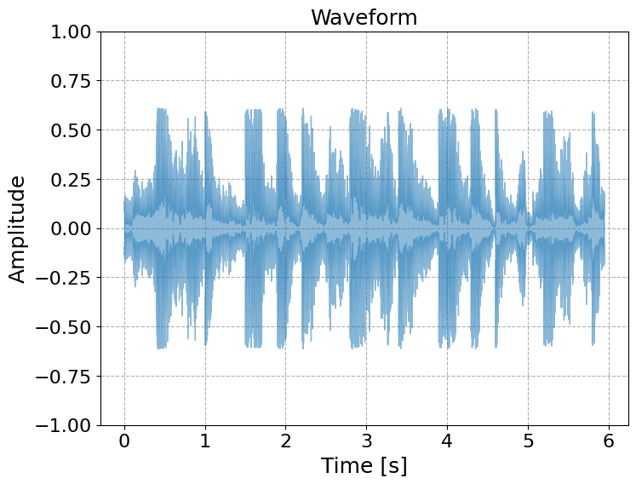
Raw audio signal
03

Slide 9
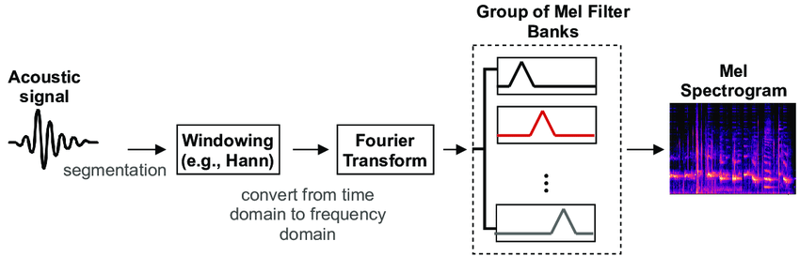
Mel spectrogram
03
The Mel spectrogram is computed from the Short-Time-Fourier-Transform of the raw signal through the FFT algorithm with a window size of 1024 and the hop size of 512. The Mel-Spectrogram is obtained by applying a bank of 128 overlapping triangular filters to the spectrogram for calculating the energy of spectrum in each band. The power amplitudes of the Mel-Spectrogram are converted to decibel (dB) scale to compress the dynamic range.
Notes:
Specifically, this research the goal is to explore the influence of AI on the art world and the responses of the people, particularly artists, to these transformations.
To do that, we examined the most popular platforms for creating AI art, we analyzed the opinions of individuals in the art world regarding AI, and discovered the prevalent terminology used when discussing AI and art.
We developed this project getting data from a famous social platform, called Twitter.
After we got the data we wanted, a network map of AI-generated art-related tweets was created, in order to visualize connections and interactions between them, and to understand how individuals are reacting to these.

Slide 10
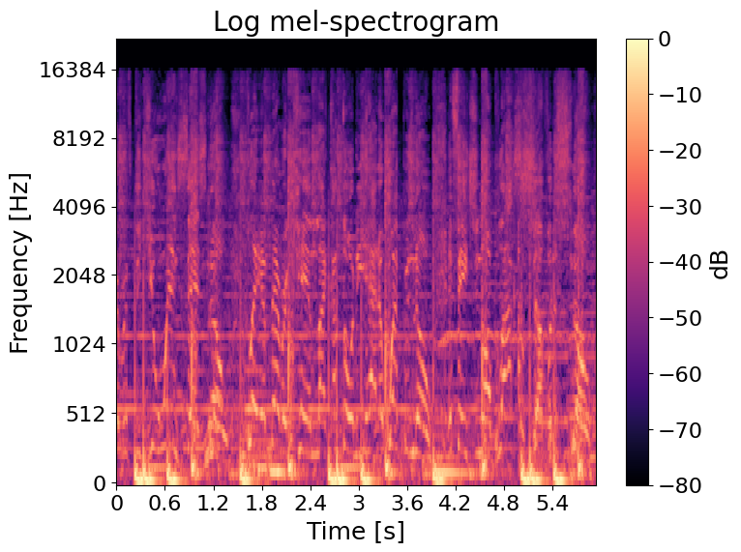
Log Mel-Spectrogram
03
Notes:
Specifically, this research the goal is to explore the influence of AI on the art world and the responses of the people, particularly artists, to these transformations.
To do that, we examined the most popular platforms for creating AI art, we analyzed the opinions of individuals in the art world regarding AI, and discovered the prevalent terminology used when discussing AI and art.
We developed this project getting data from a famous social platform, called Twitter.
After we got the data we wanted, a network map of AI-generated art-related tweets was created, in order to visualize connections and interactions between them, and to understand how individuals are reacting to these.

Slide 11
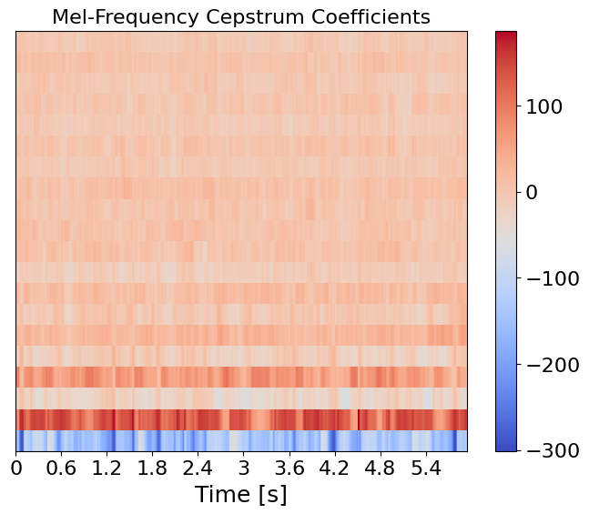
Mel-Frequency Cepstral Coefficients
03
The Mel Frequency Cepstral Coefficients (MFCCs) are obtained by applying a Discrete Cosine Transform (DCT) on a Log scale MelSpectrogram.
MFCCs are a compact representation of the sound’s spectrum, and they are less sensitive to noise than the raw spectrum.
Notes:
Specifically, this research the goal is to explore the influence of AI on the art world and the responses of the people, particularly artists, to these transformations.
To do that, we examined the most popular platforms for creating AI art, we analyzed the opinions of individuals in the art world regarding AI, and discovered the prevalent terminology used when discussing AI and art.
We developed this project getting data from a famous social platform, called Twitter.
After we got the data we wanted, a network map of AI-generated art-related tweets was created, in order to visualize connections and interactions between them, and to understand how individuals are reacting to these.

Slide 12
Preprocessing of the audio signals (2)
03
Data augmentation transforms:
Gaussian noise
Time stretching: modify the velocity of the signal
Pitch shifts

Slide 13
04
Model architectures

Slide 14
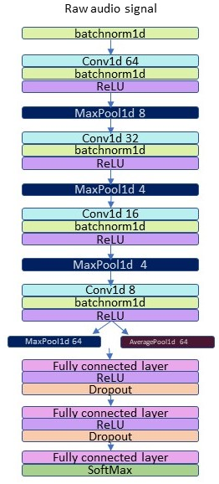
1D CNN: RawAudioCNN
04
Input Batch Normalization
4 Convolutional Blocks alternated by 3 Max Pool
Max and Average Pool along the time axis
3 Layers Classifier (ReLU + Dropout)
Softmax
Notes:
Specifically, this research the goal is to explore the influence of AI on the art world and the responses of the people, particularly artists, to these transformations.
To do that, we examined the most popular platforms for creating AI art, we analyzed the opinions of individuals in the art world regarding AI, and discovered the prevalent terminology used when discussing AI and art.
We developed this project getting data from a famous social platform, called Twitter.
After we got the data we wanted, a network map of AI-generated art-related tweets was created, in order to visualize connections and interactions between them, and to understand how individuals are reacting to these.

Slide 15
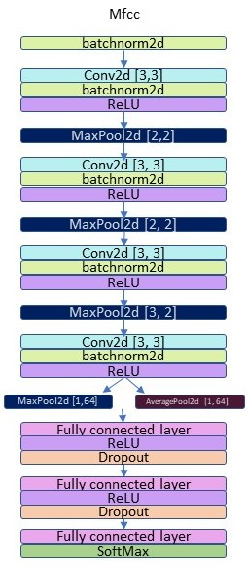
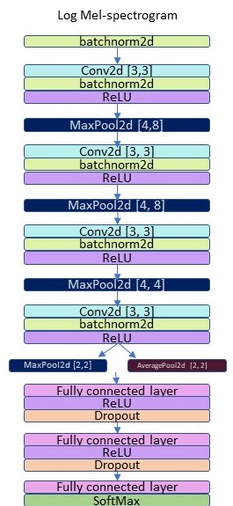
2D CNNs: MelSpecCNN & MfccCNN
04
Similar structure to the previous network
Fixed Kernel size with Stride = 1
Pooling along the time axis for MFCCs
Time-frequency pooling for Mel Spectrogram
Same classifier as before
Notes:
Specifically, this research the goal is to explore the influence of AI on the art world and the responses of the people, particularly artists, to these transformations.
To do that, we examined the most popular platforms for creating AI art, we analyzed the opinions of individuals in the art world regarding AI, and discovered the prevalent terminology used when discussing AI and art.
We developed this project getting data from a famous social platform, called Twitter.
After we got the data we wanted, a network map of AI-generated art-related tweets was created, in order to visualize connections and interactions between them, and to understand how individuals are reacting to these.

Slide 16
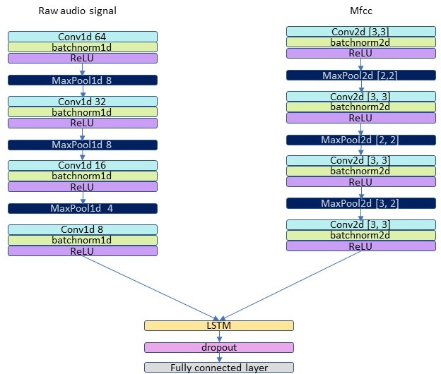
Late Fusion CRNN
04
Late Fusion: merge the features one step before the classification
Audio + MFCCs
Long-Short Memory cell: exploit sequential nature of data
Single layer classifier
Notes:
Specifically, this research the goal is to explore the influence of AI on the art world and the responses of the people, particularly artists, to these transformations.
To do that, we examined the most popular platforms for creating AI art, we analyzed the opinions of individuals in the art world regarding AI, and discovered the prevalent terminology used when discussing AI and art.
We developed this project getting data from a famous social platform, called Twitter.
After we got the data we wanted, a network map of AI-generated art-related tweets was created, in order to visualize connections and interactions between them, and to understand how individuals are reacting to these.

Slide 17
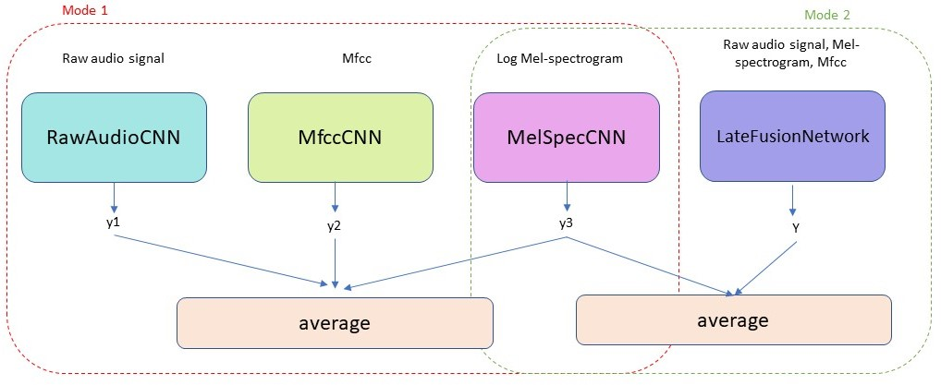
Ensemble Classifier
04
Save time and computational resources by reusing pre-trained models
Combine different classifiers to obtain a more robust model
Two modes
Notes:
Specifically, this research the goal is to explore the influence of AI on the art world and the responses of the people, particularly artists, to these transformations.
To do that, we examined the most popular platforms for creating AI art, we analyzed the opinions of individuals in the art world regarding AI, and discovered the prevalent terminology used when discussing AI and art.
We developed this project getting data from a famous social platform, called Twitter.
After we got the data we wanted, a network map of AI-generated art-related tweets was created, in order to visualize connections and interactions between them, and to understand how individuals are reacting to these.

Slide 18
05
Training

Slide 19
Training parameters
05
Multi-class cross-entropy loss
Adam optimizer with default values
ReLu activation function
Strategies to avoid overfitting:
Data augmentation
Early stopping
Dropout
Batch Normalization

Slide 20
06
Results

Slide 21
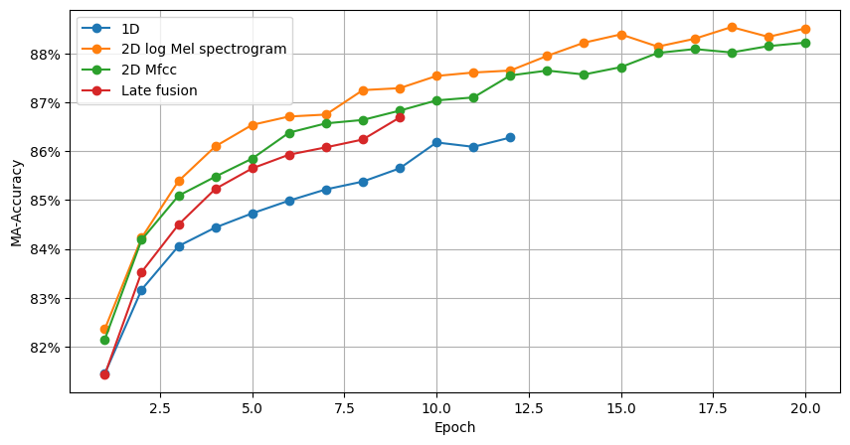
Training results - Accuracy
06

Slide 22
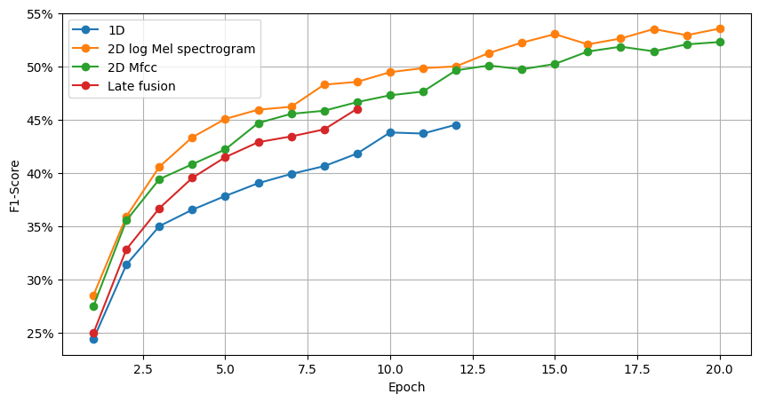
Training results - F1-score
06

Slide 23
Test results
06
Model | # weights | Accuracy | Precision | Recall | F1 score
1D CNN | 158106 | 83.66 % | 37.35% | 34.62% | 35.94%
2D CNN Mel Spectrogram | 139306 | 86.84 % | 47.90% | 47.38% | 47.64%
2D CNN MFCC | 139306 | 85.47 % | 41.37% | 41.88% | 41.62%
Late Fusion CRNN | 412728 | 84.53 % | 38.63% | 38.12% | 38.38%
Ensemble Classifier mode1 | - | 87.03% | 47.56 | 48.12% | 47.84%
Ensemble Classifier mode2 | - | 84.25% | 35.35% | 37.00% | 36.15%

Slide 24
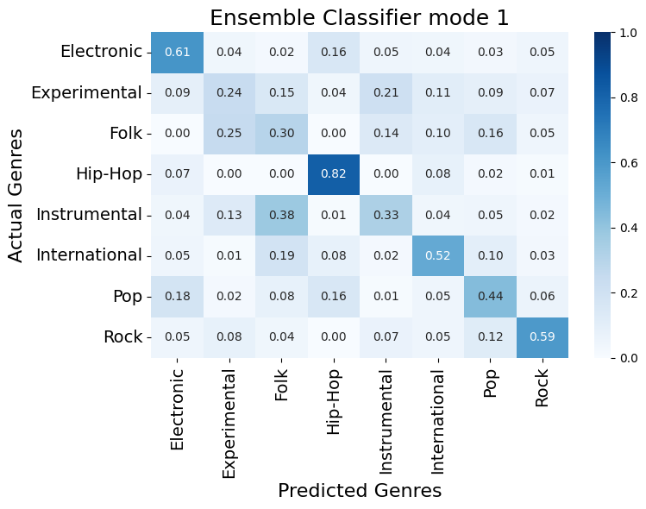
Test results
06

Slide 25
Thanks for the attention

